Slide 1

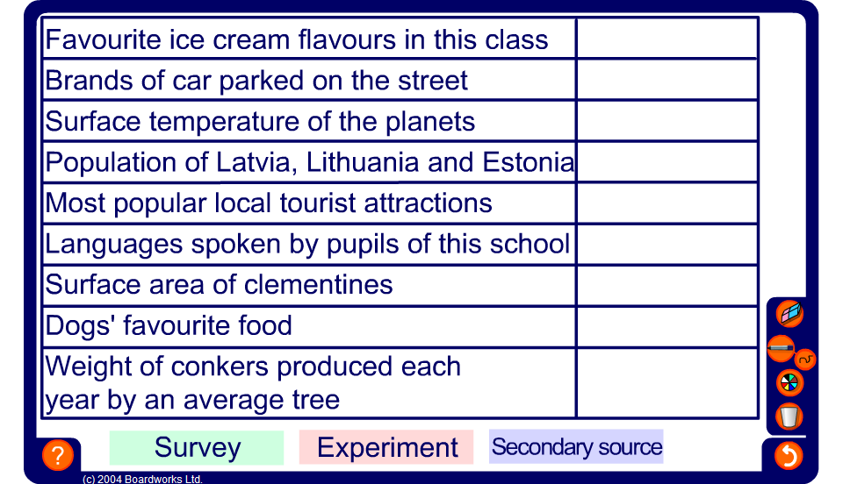


Sources of data
Notes:
Decide whether the data shown is data that would come from an experiment, a survey, or from a secondary source.

